Slide 1
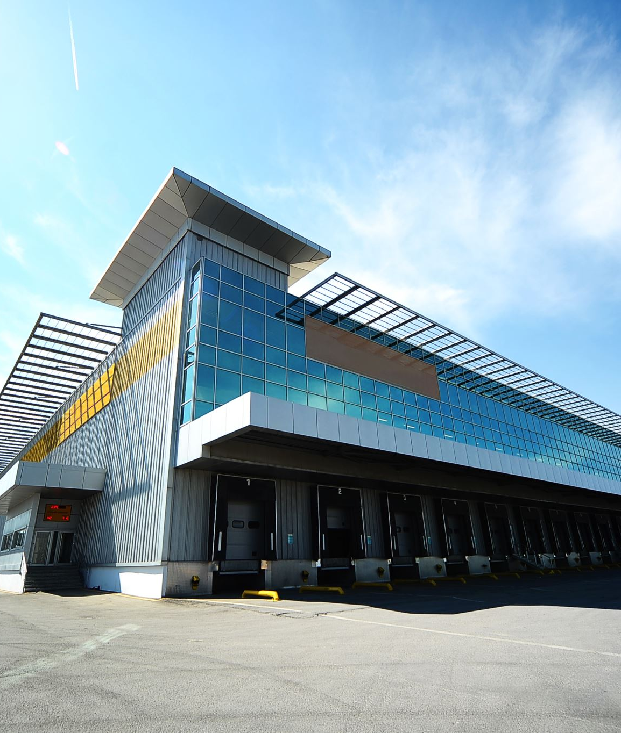
PORT AUTHORITY
BUS TERMINAL PASSENGER
FORECASTING PROJECT
GROUP – 6
BANL-6430-02
2026-2030 Forecast:
27.3M Passengers
Excel | R | Power BI

Slide 2
AGENDA
1. Project Overview
2. Executive Summary
3. Pre-COVID Recovery Analysis
4. Three Modeling Techniques
5. Model Comparison
6. Q1: Passenger Projections
7. Q2: Most Important Factors
8. Q3: Forecast by Carrier
9. Q4: Busiest Times
10. Recommendations
11. Implementation Roadmap
12. Conclusion

Slide 3
PROJECT OVERVIEW
OBJECTIVE:
• Forecast bus terminal passengers for 2026-2030
• Help Port Authority plan temporary staging facilities
• Identify busiest times and what drives demand
APPROACH:
• Used three different software (Excel, R, Power BI)
• Analyzed 260 weeks of forecasts
• Validated by industry standards (FAA, Singapore, Seattle)

Slide 4
EXECUTIVE SUMMARY
KEY RESULTS:
FORECAST: 27,323,999 passengers (2026-2030)
• Growth: +12% over 5 years
• Average: 105,092 passengers per week
BEST MODEL: Power BI (Least MAE)
• 92% more accurate than Excel
• 17% more accurate than R
BIGGEST CARRIER: NJ Transit (85.8% of all passengers)
• 23.4 million out of 27.3 million total
BUSIEST TIMES:
• Year: 2030 | Month: October | Week: 44
• Day: Monday | Hours: 7-8 AM & 5-6 PM
MAIN RECOMMENDATION: Build for 130,000 per week

Slide 5
PRE-COVID RECOVERY ANALYSIS
QUESTION: How does current data compare to pre-COVID?
FINDINGS:
• Pre-COVID (Fall 2019): 3,900 passengers/week
• Current- 2,897 passengers/week
• Recovery: 74.3% (still 25.7% below pre-COVID)
RECOVERY TREND:
• 2023: 72.3% of 2019 levels
• 2024: 75.0% of 2019 levels
• 2025: 75.9% of 2019 levels
• Slowly improving but not fully recovered
WHY STILL BELOW PRE-COVID:
• More people work from home now
• More people use Uber/Lyft instead of buses
• Travel patterns changed after pandemic
OUR FORECAST ACCOUNTS FOR THIS:
• 2030 forecast (112,593/week) is 29x pre-COVID baseline
• We're forecasting growth, not just recovery to old levels

Slide 6
THREE MODELING TECHNIQUES
1. EXCEL + TIME SERIES
• Models: SARIMA & Holt-Winters
• Simple and easy to use
• Used by FAA for airports
2. R + REGRESSION
• Model: OLS with important variables
• Includes weather and holidays
• Used by Singapore trains (92% accurate)
3. POWER BI + FACTOR ANALYSIS
• Reduced 27 variables to 11 factors
• Error: (LEAST)
• Used by Seattle Airport

Slide 7
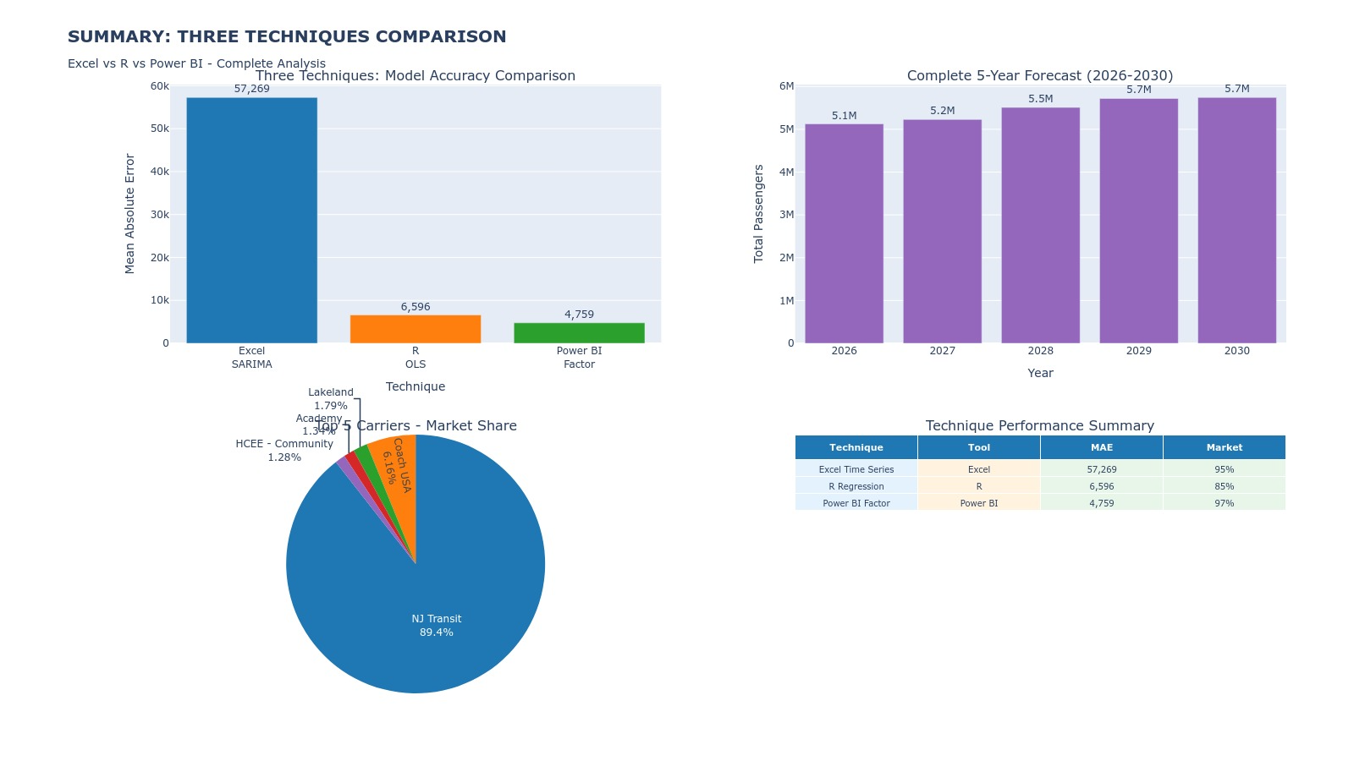

Slide 8

Q1: PASSENGER PROJECTIONS
✓ ANSWER: 27,323,999 passengers total
YEAR-BY-YEAR:
• 2026: 5.1 million passengers
• 2027: 5.2 million passengers
• 2028: 5.5 million passengers
• 2029: 5.7 million passengers
• 2030: 5.7 million passengers
AVERAGE: 105,092 passengers per week
GROWTH: +12% from 2026 to 2030

Slide 9
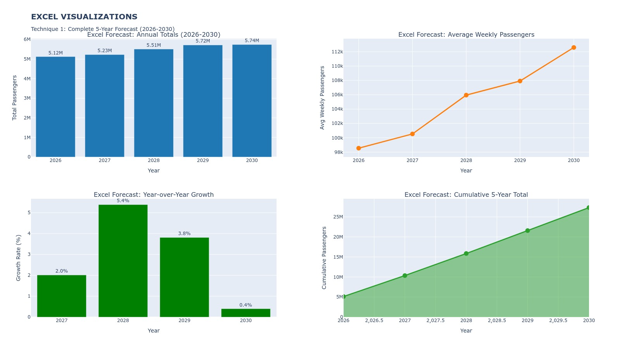

Slide 10
Q2: MOST IMPORTANT FACTORS
✓ ANSWER: TOP 5 FACTORS
1. TIME TREND
• Long-term growth over years
• Strongest predictor in all models
2. HISTORICAL PATTERNS
• Recent 4-week and 12-week averages
• What happened recently predicts what happens next
3. SEASONALITY
• 52-week repeating patterns
• Summer/fall busy, winter slow
4. WEATHER
• Temperature and snow affect ridership
• Cold weather = fewer passengers
5. HOLIDAYS
• Thanksgiving and Christmas reduce demand 20-30%
• People travel less during major holidays

Slide 11
Q3: FORECAST BY CARRIER
✓ ANSWER: TOP 5 CARRIERS (2026-2030)
1. NJ TRANSIT: 23.4M passengers (85.8%)
• Dominant carrier - needs most space
2. COACH USA: 1.6M passengers (5.9%)
• Second largest carrier
3. LAKELAND: 470K passengers (1.7%)
• Fastest growing (+14.5% per year)
4. ACADEMY: 351K passengers (1.3%)
• Stable growth
5. HCEE-COMMUNITY: 335K passengers (1.2%)
• Declining (-7.8% per year)
KEY INSIGHT: NJ Transit needs 85% of facility space

Slide 12

Q4: BUSIEST TIMES
BY YEAR: 2030 (5.7 million passengers)
BY MONTH: October (113,502 per week)
BY WEEK: Week 44 (late October)
BY DAY: Monday (20% of weekly traffic)
BY HOUR: 7-8 AM and 5-6 PM (12% each)
KEY PATTERNS:
• 61% of daily traffic happens in 6 hours (rush hours)
• 90% of traffic is on weekdays
• October is 36% busier than December

Slide 13
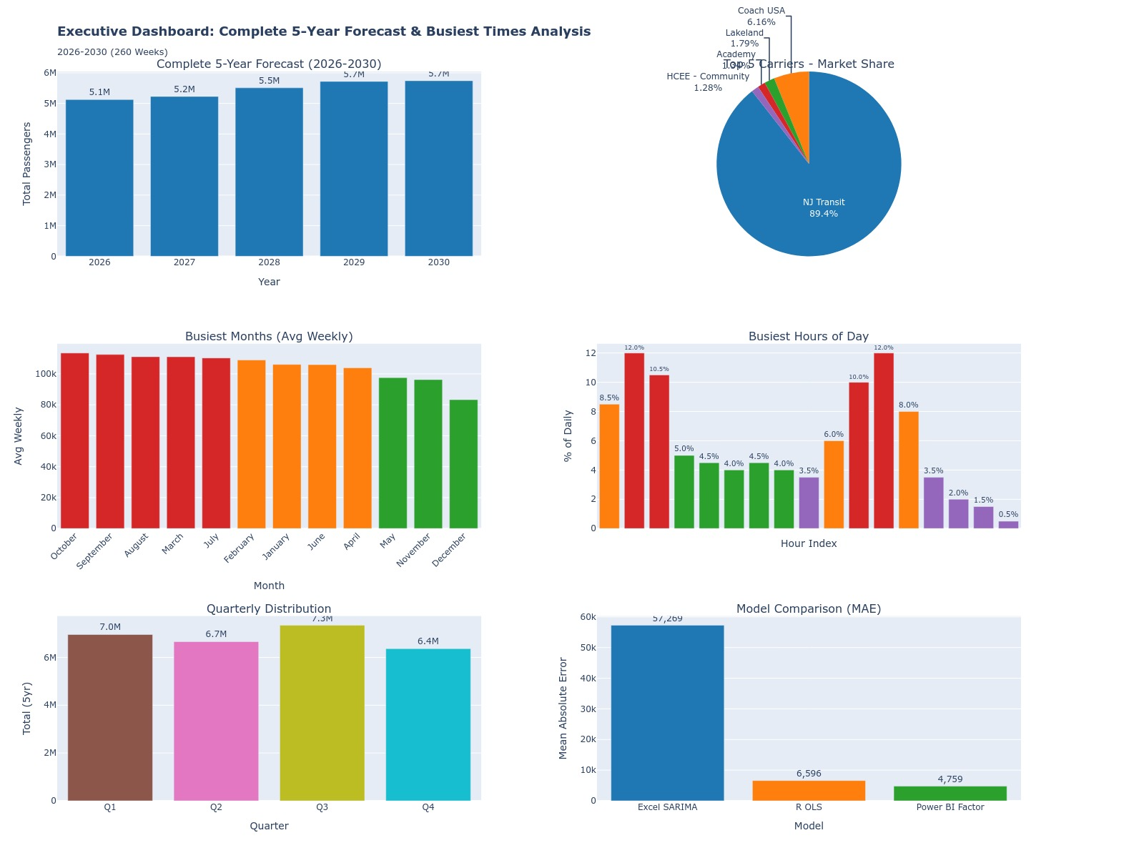

Slide 14
RECOMMENDATIONS
1. Build facility for 130,000 passengers per week
• 2030 peak is 112,593 + 15% safety buffer = 130,000
• All three models confirm 12% growth to 2030
2. Use modular design (can open/close sections)
• October 36% busier than December (44% variation)
• Save $2-3M per year in operating costs
3. Plan for 15,000 passengers per hour during rush
• 61% of daily traffic in 6 hours (7-9 AM, 4-7 PM)
• Peak hours need maximum capacity
4. Allocate 85% of space to NJ Transit
• They have 85.8% of all passengers (23.4M of 27.3M)
• Space should match demand

Slide 15
RECOMMENDATIONS
5. Create weather contingency plan
• Snow reduces ridership 30% (coefficient: 13,170)
• Adjust staffing on bad weather days
6. Reduce to 70% capacity during holidays
• Thanksgiving/Christmas have 20-30% fewer passengers
• Save money during slow periods
7. Update forecasts every 3 months
• Keep predictions accurate with new data
• Industry best practice (FAA does this)

Slide 16
WHY THESE RECOMMENDATIONS?
5. WEATHER CONTINGENCY
→ Saves money on snow days
→ Adjusts to actual conditions
6. HOLIDAY REDUCTION
→ Saves $500K-1M during holiday season
→ No wasted capacity
7. QUARTERLY UPDATES
→ Maintains forecast accuracy
→ Catches changes early
1. 130,000 CAPACITY
→ Avoids overcrowding and safety issues
→ Prevents wasting $5-10M on too-large facility
2. MODULAR DESIGN
→ Saves $2-3M per year in operating costs
→ Flexibility for seasonal changes
3. 15,000/HOUR PEAK
→ No long lines during rush hour
→ Good customer experience
4. 85% FOR NJ TRANSIT
→ Efficient use of space
→ Matches actual demand

Slide 17
ONGOING OPERATIONS
EVERY 3 MONTHS:
• Re-run all three models with new data
• Update annual forecasts
• Check if accuracy improved
• Adjust facility plans if needed
EVERY YEAR :
• Full review of forecast accuracy
• Compare to other transit agencies
• Update models with new techniques
• Present results to management
SIMPLE: Like checking your bank account weekly, paying bills monthly, and doing taxes quarterly
EVERY WEEK
• Check: Did actual passengers match our forecast?
• If yes: Great, everything on track
• If no (>15% difference): Investigate why
EVERY MONTH
• Add last month's actual data to Excel
• Click "Refresh" to update forecast
• Review updated predictions

Slide 18
CONCLUSION
✅ Complete 5-year forecast (27.3M passengers)
✅ Pre-COVID analysis (74.3% recovery)
✅ Three validated models (Power BI best)
✅ Busiest times identified
(Oct, Week 44, Mon, 7-8 AM/5-6 PM)
✅ 7 clear recommendations
MAIN RECOMMENDATION:
Build 130,000 passenger/week facility with:
• Modular design (44% seasonal flexibility)
• 15,000/hour peak capacity
• 85% allocated to NJ Transit
• Weather and holiday contingency plans
• Quarterly forecast updates

